Slide 1
Pegasus For
Automated Workflows
Derrick Kearney
HUBzero® Platform for Scientific Collaboration
Purdue University
This work licensed under
Creative Commons
See license online:
by-nc-sa/3.0

Slide 2



Submitting from a Workspace
User's Workspace Terminal
HUBzero Infrastructure
$ submit -p @@Vin=1-5 ./sim1.py --Vin @@Vin
Tool Session
Containers
Submit
Proxy
Grid
Grid
Grid
Grid
Grid
Grid

Slide 3
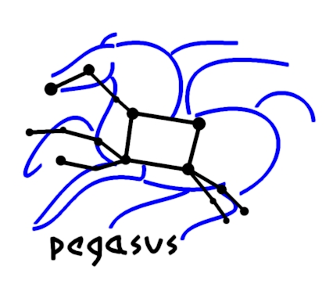
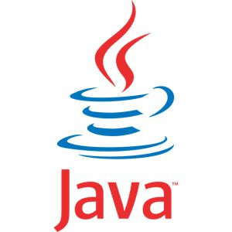

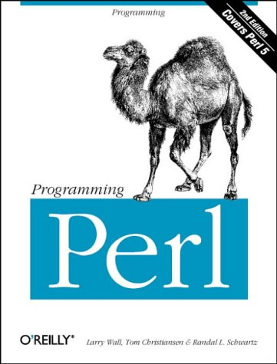
Pegasus Workflow Management
DAX
HUBzero Infrastructure
Developed at USC
Ewa Deelman et al.
Website: pegasus.isi.edu
Manage jobs on the grid
Open Source
Bindings for your
favorite languages:
Tool Session
Containers
Submit
Proxy
Grid
Grid
Grid
DAG
Benefits:
Performance
Portability
Provenance
Data Management
Error Recovery
Grid
Grid

Slide 4
Let Submit create a workflow ...
User's Workspace Terminal
HUBzero Infrastructure
$ submit -p @@Vin=1-5 ./sim1.py --Vin @@Vin
scatter
Tool Session
Containers
Submit
Proxy
Vin=1
Vin=2
...
Vin=5
Grid
Grid
Grid
Grid
Grid
Grid
gather

Slide 5
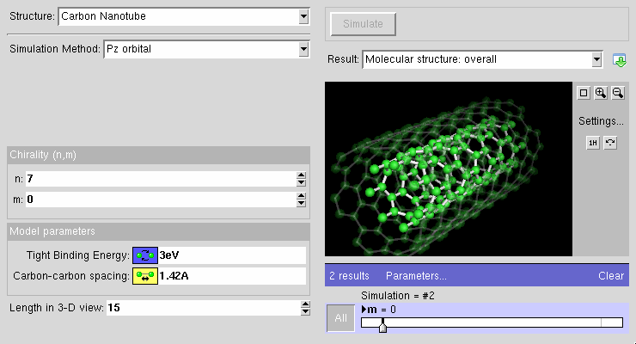
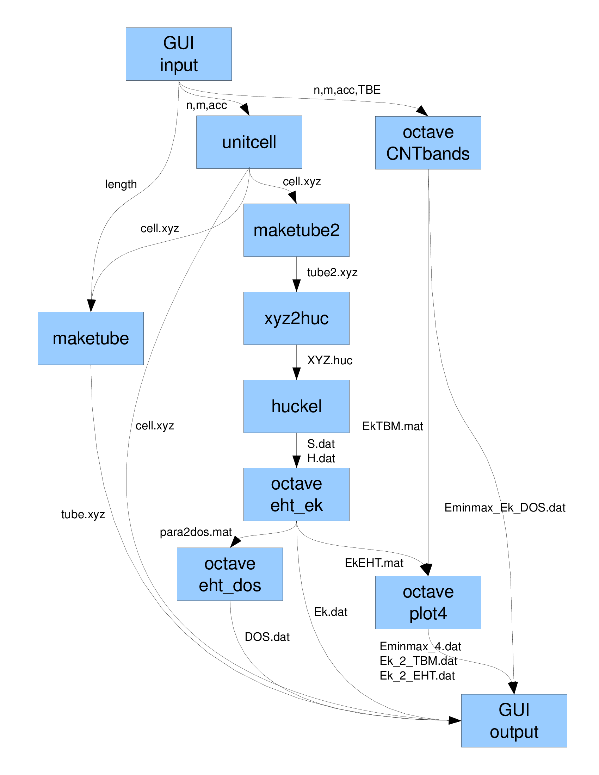
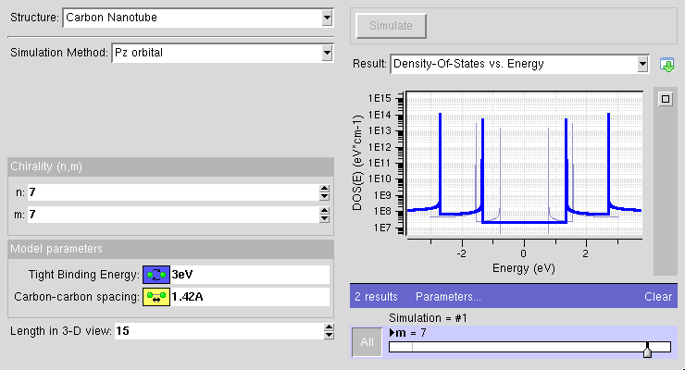
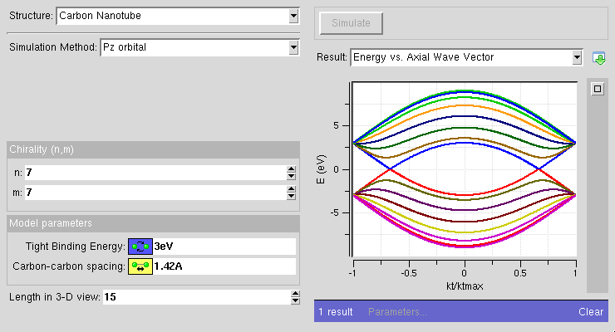
… or write your own workflow
CNTBands
Science Domain: Nanoelectronics
Scientists: Lundstrom et al. (Purdue)
https://nanohub.org/resources/cntbands-ext

Slide 6

Example Workflow
HUBzero Infrastructure
f.a
sayhi
Tool Session
Containers
$ cat /apps/pegtut/current/bin/sayhi.sh
#!/bin/bash
# output something on stdout
echo "Hello `cat ${1}`!"
# print greeting to a file
echo "Hello `cat ${1}`!" >f.b
f.b
sayhi.sh
inquire
inquire.sh
f.a
f.c

Slide 7
Example Workflow
HUBzero Infrastructure
f.a
sayhi
Tool Session
Containers
$ cat /apps/pegtut/current/bin/inquire.sh
#!/bin/bash
# output some thing to stdout
echo "`cat ${1}` How are you?"
# print greeting to a file
echo "`cat ${1}` How are you?" >f.c
f.b
sayhi.sh
inquire
inquire.sh
f.a
f.c

Slide 8
Example Workflow
HUBzero Infrastructure
f.a
sayhi
Tool Session
Containers
$ cat f.a
pete
f.b
sayhi.sh
inquire
inquire.sh
f.a
f.c

Slide 9
How does Pegasus Work?
Step 1. Draw the workflow
f.a
sayhi
f.b
inquire
f.c

Slide 10
How does Pegasus Work?
Step 2. Convert Workflow to DAX
DAX
f.a
sayhi
f.b
DAG
inquire
Grid
Grid
f.c

Slide 11
How does Pegasus Work?
Step 2. Convert Workflow to DAX using the Python API
f.a
import os
from Pegasus.DAX3 import *
sayhipath = '/apps/pegtut/current/bin/sayhi.sh'
inquirepath = '/apps/pegtut/current/bin/inquire.sh'
# create an abstract DAX
dax = ADAG("sayhi_inquire")
sayhi
f.b
inquire
f.c

Slide 12
How does Pegasus Work?
Step 2. Convert Workflow to DAX – Declare files and executables to replica catalog
f.a
# Add input file to the DAX-level replica catalog
a = File("f.a")
a.addPFN(PFN("file://" + os.path.join(os.getcwd(),"f.a"), "local"))
dax.addFile(a)
# Add executables to the DAX-level replica catalog
e_sayhi = Executable(namespace="sayhi_inquire", \
name="sayhi", version="1.0", \
os="linux", arch="x86_64", \
installed=False)
e_sayhi.addPFN(PFN("file://" + sayhipath, "local"))
dax.addExecutable(e_sayhi)
e_inquire = Executable(namespace="sayhi_inquire", \
name="inquire", version="1.0", \
os="linux", arch="x86_64",
installed=False)
e_inquire.addPFN(PFN("file://" + inquirepath, "local"))
dax.addExecutable(e_inquire)
sayhi
f.b
inquire
f.c

Slide 13
How does Pegasus Work?
Step 2. Convert Workflow to DAX – Add jobs to the DAX
f.a
# Add the sayhi job
sayhi = Job(namespace="sayhi_inquire", \
name="sayhi", version="1.0")
sayhi.addArguments('f.a')
b = File("f.b")
sayhi.uses(a, link=Link.INPUT)
sayhi.uses(b, link=Link.OUTPUT)
dax.addJob(sayhi)
# Add the inquire job (depends on the sayhi job)
inquire = Job(namespace="sayhi_inquire", \
name="inquire", version="1.0")
inquire.addArguments('f.b')
c = File("f.c")
inquire.uses(b, link=Link.INPUT)
inquire.uses(c, link=Link.OUTPUT)
dax.addJob(inquire)
sayhi
f.b
inquire
f.c

Slide 14
How does Pegasus Work?
Step 2. Convert Workflow to DAX – Add jobs to the DAX
f.a
# Add the sayhi job
sayhi = Job(namespace="sayhi_inquire", \
name="sayhi", version="1.0")
sayhi.addArguments('f.a')
b = File("f.b")
sayhi.uses(a, link=Link.INPUT)
sayhi.uses(b, link=Link.OUTPUT)
dax.addJob(sayhi)
# Add the inquire job (depends on the sayhi job)
inquire = Job(namespace="sayhi_inquire", \
name="inquire", version="1.0")
inquire.addArguments('f.b')
c = File("f.c")
inquire.uses(b, link=Link.INPUT)
inquire.uses(c, link=Link.OUTPUT)
dax.addJob(inquire)
sayhi
f.b
inquire
f.c

Slide 15
How does Pegasus Work?
Step 2. Convert Workflow to DAX – Add control-flow dependencies
f.a
# Add control-flow dependencies
dax.addDependency(Dependency(parent=sayhi, child=inquire))
sayhi
f.b
inquire
f.c

Slide 16
How does Pegasus Work?
Step 2. Convert Workflow to DAX – Write DAX to file
f.a
# Write the DAX to file
with open('sayhiinquire.dax','w') as fp:
dax.writeXML(fp)
sayhi
f.b
inquire
f.c

Slide 17
Running the DAX
DAX
Step 3. Run the workflow using Submit and Pegasus
f.a
$ submit pegasus-plan --dax sayhiinquire.dax
sayhi
DAG
f.b
inquire
Grid
Grid
f.c

Slide 18
Running The DAX
User's Workspace Terminal
HUBzero Infrastructure
$ submit pegasus-plan --dax sayhiinquire.dax
(989.0) Job Submitted at WF-DiaGrid
(989.0) DAG Running at WF-DiaGrid
…
(989.0) DAG Done at WF-DiaGrid
$ cat f.b
Hello pete!
$ cat f.c
Hello pete! How are you?
Tool Session
Containers
Submit
Proxy
Grid
Grid
Grid
Grid

Slide 19
Try creating and running a DAX
User's Workspace Terminal
HUBzero Infrastructure
Tool Session
Containers
$ use pegasus-4.5.3
$ geany f.a
$ cp -r /apps/pegtut/current/examples/sayhi_inquire .
$ cd sayhi_inquire
$ ./createdax.py
$ submit pegasus-plan –dax sayhiinquire.dax
Submit
Proxy
Grid
Grid
Grid
Grid

